Slide 1

Introduction to
Insurance

Slide 2
Insurance: the concept
Humans are exposed to many serious risks, such as property losses from fire or theft, and personal losses from disability and death.
Although individuals can not prevent or predict such occurrences, they can provide for their financial effects.
The function of Insurance is to safeguard against such misfortunes is by pooling contributions of the many to pay for the losses of the unfortunate few.
Essence of Insurance: Sharing the losses of few amongst a group of people through a
planned contribution, premium

Slide 3
Risk
Risk is defined as uncertainty concerning the occurrence of a loss.
Pure risk
Situation in which the only possibilities are
loss or no loss
Examples
Property destruction
Injury to employees on the job
Illness or death
Injury to customers and third parties
Damage to the property of others
Speculative Risk
Situation in which either gain or loss
is possible
Examples
Starting a business
Introducing a new product/entering a new market
Investing in a security
Change in government regulation
Change in customer preference

Slide 4
Risk Management
Risk Management is a method regarding how to treat exposures to risk and loss in value from any source.
Risk Management Process
Identification of risks
Evaluation of frequency and severity of losses
Choosing risk management methods
Implementation of the chosen methods
Monitoring the performance and suitability of the methods.
Methods to handle Risks
Risk Avoidance
Loss control
Self assuming losses ( self insurance)
Alternative risk transfers
Insurance

Slide 5
Insurance : an economic perspective
Insurance is a financial function by which individuals exposed to a specified risk
contribute to a pool from which losses suffered by participating individuals for the covered
events are paid out.
Exposure to
Risks
Individuals
Transfer of Risk
Substitution of a structured contribution Premium for an uncertain large loss
Examples:
Property(Home,Car) losses from fire
Personal losses from incapacity, death
Premium
Insurer’s
Pool
Benefits
(Loss Experienced)

Slide 6
Basic characteristics of insurance
Risk transfer – From insured to insurer. Insurance deals only with pure risks
Indemnification – Restoring the insured to the original position without any financial loss or gain
Larger number of exposure units
Coverage of fortuitous losses – Accidental losses not intentional
Determinable and measurable losses – cause, time, and amount
No Catastrophic loss
Calculable probability of loss – history or a priori to determine
Economically feasible price – means chance of loss must be relatively low
Characteristics of insurable risks

Slide 7
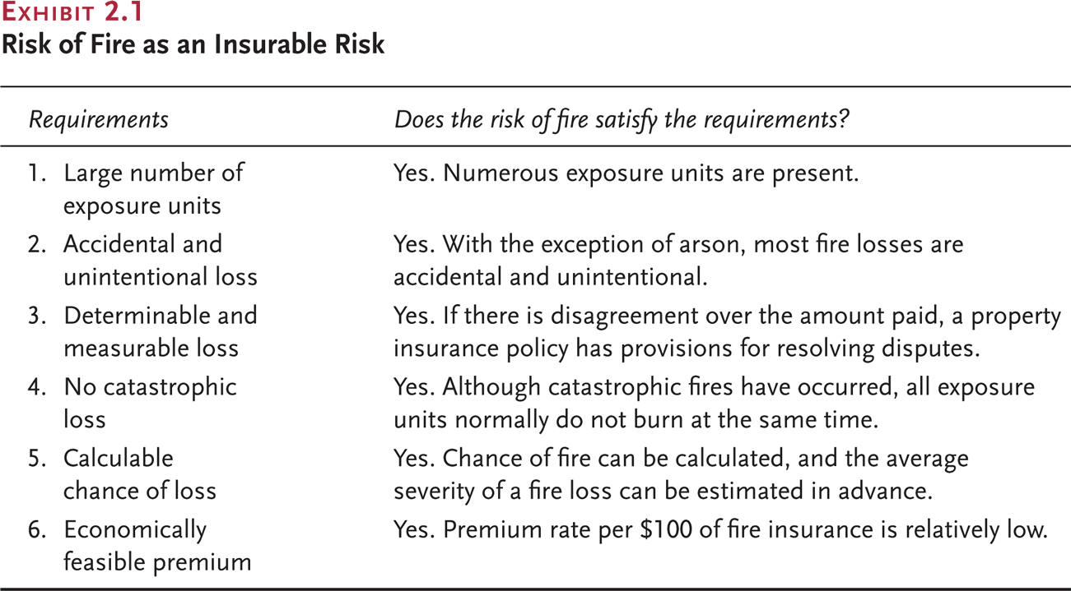
Examples of insurable risks (1/2)

Slide 8
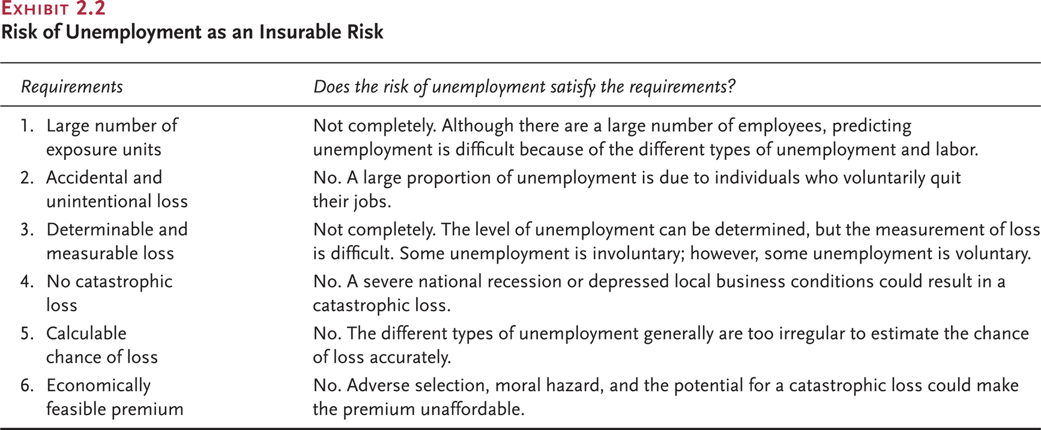
Examples of insurable risks (2/2)

Slide 9
Insurance relies on large numbers of individuals contributing to the pool
EXAMPLE
Insurance against death for one year
A single person
100 persons
500,000 persons
Insurance is having the losses of the unfortunate few paid by the contributions of the many who are exposed to the similar risk(s).
Uncertainty
How many will
suffer losses?
Will he die during the year?
Only god knows.
How many will die during the year?
Only Speculation
How many will die during the year?
Observed death rates will vary from expected rates(from the population tables) by less than 1%
The Law of Large Numbers, applied to Insurance,holds that the greater the number of similar
exposures to a risk, the less observed loss experience will deviate from expected loss
experience. Uncertainty of how many will suffer losses decreases as the number of exposure
Units increases.

Slide 10
Insurance pricing elements
1
The probability of
the insured event
Occurring
Likelihood of losses
For Ex:
Mortality tables show yearly probabilities of death
Age
Premium
(life)
Smoking-”Y”
Premium
(life)
2
Part of Premiums collected is invested to produce earnings which can supplement future premiums.
Time
(Premium
paying
term)
The time value of money
Premium
3
The benefits promised
Types of coverage, Terms of coverage, Additional benefits, Conditional Benefits
Benefits
Premium
4
Loading to cover expenses, commissions
taxes, profits and other
contingencies
+
=
Gross Rate
Net Rate

Slide 11
Types of Insurance products
Insurance products differ with regards to the perils covered. A peril is a cause of loss.
Example: If the house burns because of fire, the peril or cause of loss is “fire”.
Private Insurance
Government Insurance
Social insurance – FICA, Workman’s Comp. compulsory disability
Unemployment Insurance
Other government insurance programs
Ex: crop insurance etc.
Life &
Health Insurance
Life Insurance
Annuities & Pension
disability and long-term care insurance
health insurance,accident insurance and medical expense insurance
Takaful or Islamic Insurance
Non-Life Insurance
(Property & Casualty Insurance)
Property losses-damage to or destruction of homes, autos, businesses, aircrafts
Liability losses-payments due to professional negligence, product defects etc.
Other forms of Non-Life Insurance
Marine Losses-damage to ships, & cargo
Engineering Losses-destruction to industrial equipments
Agriculture Losses – damage to crops
Specialty Losses –unique risks such as Satellite risk, Oil rigs etc.

Slide 12
Benefits of insurance Cons of insurance
Financial security to the Insured
More productivity-less fear and worry
Prevents blockage of individual’s fund
Financial stability to commerce & community
Funds for Investment in Infrastructure
Reduction in losses
Eases burden on governments
Passive foreign exchange earner
Adverse Selection: People with higher than average chance of loss seek insurance
Moral Hazard: People alter their behavior because of insurance.
  Fraudulent claims – fake thefts, auto, health
  Inflated claims
  Speculators

Slide 13
Insurance as a contract
Insurance is an agreement (Insurance contract / Policy), by which the Policyowner pays a
stipulated consideration, Premium to the other party Insurer, in return for which the
insurer agrees to pay a defined sum of money or provide defined benefits if a covered
event occurs during the policy term.
Characteristics of Insurance Contracts
Utmost good faith: Each party is entitles to rely in good faith upon the representations of the other, and each is under an obligation not to attempt to deceive or withhold information from the other
Adhesion: The terms and provisions are fixed by one party (the insurer)
Values Policies: Life & Health policies are valued policies, meaning that insurer agrees to pay a stated sum irrespective of the actual economic loss
Contract of Indemnity: Non-life policies pay a stated sum to restore to original position before loss
Unilateral: Only insurers make a legally enforceable promise
Aleatory: The contract involves the element of chance, and one party may receive more than the other
Conditional: Insurer’s obligation to pay benefits depends upon payment of premiums, and furnishing proof of loss

Slide 14
Insurance contract terms
Assignee
Absolute assignee has all the rights in the policy
Collateral Assignee has only some policy rights temporarily.
Assignment of rights
Policyowner
The person who owns the contract and can exercise all rights under the policy
Beneficiary
The person to whom life insurance policy death benefits are paid.
Contract
Insurance
Company
Insurable Interest
Policyowner can expect to suffer financial loss on the insured’s death or loss of good health.
Or
Policyowner can expect to suffer financial loss on the loss in value of subject matter
Subject Matter
Insured :The person whose life or health is the object of the insurance contract
The property/liability or financial loss for which Insurance is being taken

Slide 15
Insurance company overview
Agent: A person who represents an insurance company to sell insurance products
Government
Regulation
Taxation
Underwriter: A person who determines whether and what terms to issue requested insurance.
Distribution
Agents
Brokers
Direct
response
Processing
Underwriting
Pricing
Application
processing
Claims handling
Policy owner
servicing
Financial
Management
Investment
Asset-liability
management
Customers
Individuals
Business
Financial
Market
Reinsurer: An Insurance company which assumes risks of another insurance company
Reinsurers
Other Players
Rating agencies
Actuary: A person who determines insurance premiums(the price of insurance products)

Slide 16
Insurance company operations as per policy lifecycle
Investment Management
Product Development
Distribution
New Business
Policy
Servicing
Claims Management
Billing &
Collection
Establish premium rates,
liability reserves,cash values(done by actuaries)
Design new policies & forms and get approval from regulatory authorities
Simplify existing products and add innovative features
Develop effective policy sales capability through agency and non-agency approach
Prepare and manage direct sales campaign
Develop broader customer relationship management strategies
Develop seamless interaction capabilities with distribution channels & customers
Process applications for insurance
Underwrite applications for insurance
Issue policies
Manage claims cases across multiple channels
Gather information about the claim, the claimant, and the beneficiary
Investigate about the doubtful claims
Make claims and instruct to release death proceeds if necessary
Customer
Service
Manage investment programs & accounting practices
Administer policies from time of issuance until termination
Send premium notices and manage premium collection
Service customers across multiple channels

